Slide 1
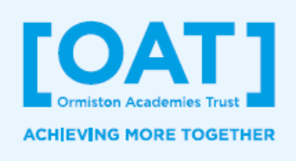
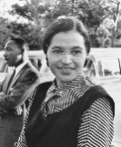
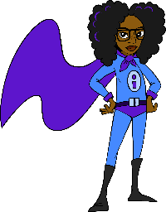
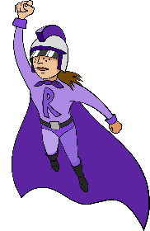
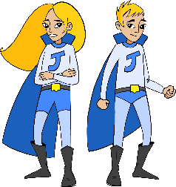
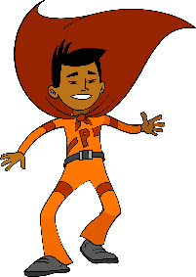





Students will start LKS2:
Knowing who is special in their lives, including their friends and family
Having a basic understanding of healthy choices
With an understanding of how to stay safe
With a foundation of CRL and financial education
Having had an experience of YSA
KS1 PSHE Education Learning Journey
What can I do to help the world?
What can I do to help people feel happier?
How can screen time and sleep affect the way we feel?
How can I describe my emotions?
Caring for the Environment & Social Responsibility
Healthy Minds
What special things have people done in the past to ensure everyone is included?
How can I help wildlife?
Who really lives in my local environment?
How can you look after your feelings and care for yourself?
Why is it important to look after our minds and wellbeing?
How do I eat a healthy diet?
Why is
sleeping
healthy?
How do I keep clean & healthy?
How can we make people feel welcome and included?
How can I be a champion for inclusion?
How can we get healthier?
Healthy Bodies Feeling Included
What is discrimination?
How do I have amazing table manners?
Who can I talk to if things don’t feel right?
How can
we include everyone in our games?
How can we solve problems with friends when we fall out?
What and who keeps us healthy as we grow up?
What is a wedding and why do people get married?
How are families different and the same?
How does Independent Isha become an effective learner?
What can we learn from Resilient Riley and Creative Curtis?
Different Types of families Growth Mindset
Enrichment & careers related learning opportunities in KS1:
The OAT Advantage:
Know how to be kind
Understand what manners are & why they are important
#iwill social action opportunity
Pass on a knowledge or skill
Learn your address, including postcode, and your phone number
How to contact emergency services
Be aware of internet safety
Make something you can share with others
Know how to use a knife and fork
Knowledge of important current & historical figures
Learn how to ride a bike
CRL encounters from:
A member of the school community
A person that keeps the children safe, such as a firefighter, police officer, doctor or paramedic
A person that keeps the children healthy, such as a doctor, nurse, midwife, nutritionist or pharmacist
Females working in STEM
A vicar or registrar
How do you spend time with your family?
What is a family?
How can Petr Participate and Collaborative Twins Jade and Jacob help themselves and other learn?
YEAR
2
How do I feel about my beautiful world?
Can we make new products from things we would have thrown away?
Social Action: All Around Us
How can we take action to create a more eco-friendly school?
What job would I like to do when I grow up?
How can we reduce rubbish?
How can we make a difference in our class about rubbish?
Where do adults get their money?
How can being online be unhealthy?
How much sugar is in my lunch?
Healthy Me
How does exercise keep me healthy?
CRL &
Money Matters
How can I keep my money safe?
Where does my money come from?
How can we keep healthy in the sun?
Why is sugar bad for my teeth?
What keeps me safe at school?
How can we keep ourselves safe by, and on the road?
How can we keep ourselves safe with people we do not know?
Staying safe
What keeps me safe outside?
How can we keep ourselves safe at home?
How can we keep ourselves safe online ?
Who are the special people in my life and why are they special?
How can emotions change people’s behaviour?
How can I climb out of the learning pit?
What are our ground rules in PSHE lessons?
YEAR
Feelings & Special People New beginnings
1
What makes me special?
What are feelings and how can I show them?
What are the differences between Yr. R and Yr. 1?

