Slide 1
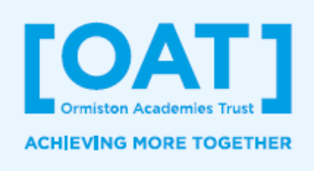



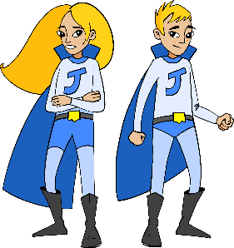
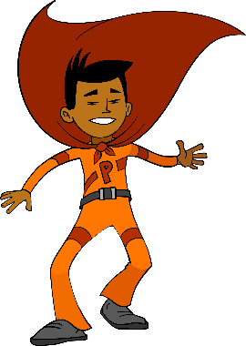
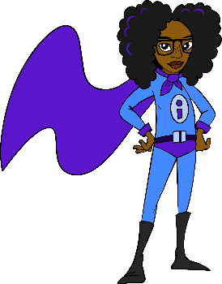
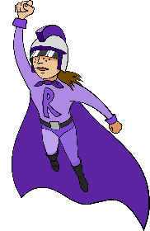
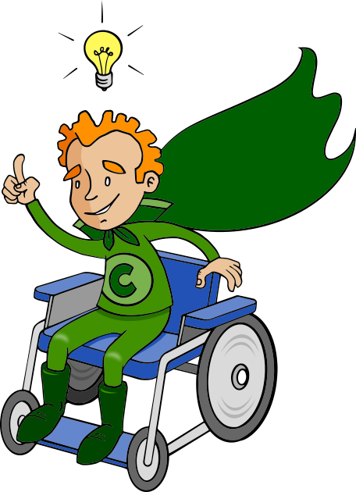
Students will start Upper Key Stage 2 with:
Understanding of how to be a good friend, including showing respect for others
Knowledge of their rights and responsibilities, as detailed in the UNCRC, including an ability to recognise stereotyping
An understanding of how to stay safe, including online, & what to do in emergencies
Knowledge of how to live a healthy lifestyle, including a balanced diet, the importance of exercise, sleep and dental health
Experience of meaningful YSA; environmental, community-based & enterprise
`
YSA Enterprise Project: How does business work and how can we help others?
Lower KS2 PSHE Education Learning Journey
What can we do to earn money?
YSA: How can we say ‘thank you’ for the work that the emergency services do?
How can we prevent
fire-based emergencies
and keep ourselves safe?
How can I keep my teeth healthy and what are the benefits?
How can I plan and create healthy meals?
What does society do to manage our money?
Money
Matters
Emergency
situations
Nutrition &
Dental Health
Where does money come from and how can it be used?
How can we keep safe near water?
What is an emergency? What is first aid?
How can I recognise when I am not physically well or my body is becoming unhealthy & what can I do?
What is a poor diet & how does being unhealthy affect us?
Is teasing respectful?
How can we show respect to others when friendships break down?
Who are my five trusted people?
How can I stand up for myself?
Respect, falling out & making up
What is a healthy diet?
Why is friendship important?
What makes a good friend?
What can we do when we fall out with friends?
What does it feel like to be excluded?
What does a healthy friendship look like?
What makes me happy and how can I help bring some happiness to others?
YSA: The UNCRC Outright Campaign
What rights and responsibilities do we have in our classroom?
Do we all have the right to play?
Human Rights
Enrichment & careers related learning opportunities in LKS2:
The OAT Advantage:
Know how to make friends
Know how to be kind
Be aware of internet safety
Learn about water safety
Raise money for charity or take part in a fundraising event
Know your legal rights and responsibilities
To have an understanding of important current & historical figures
I can cook a simple, healthy meal
Understand the value of money
Know why & how to stand up for others (prevent bullying)
Help someone in your community
#iwill social action opportunity
CRL encounters from:
Employees in computer-based industries: computer programmers, games designers, CAD design or engineering
Employees in health-based industries: personal trainer, occupational therapist, nutritionist, doctor, dentists & hygienists
Employees in the Law
Employees in emergency services: police, fire & water
Employees that challenge gender stereotypes
Employees in business & finance: banking, marketing, sales, HR
What happens when rights are taken away?
What is the UNCRC?
YEAR
How can I know what to say when people say things based on stereotypes?
What is my class community?
What is my family community?
4
YSA: Being part of a community
How can we design a community centre that is suitable for everyone?
How do I belong to my community?
How can I help people in my community?
What is it like when people make assumptions about you?
Are we all the same?
What decisions are mine to make?
What do I do if I don’t agree?
What are my likes and dislikes?
Stereotypes
What I like
Can we change traditional stereotypes?
What can I do and where can I go for help if I am worried or feel uncomfortable?
What is important to me?
What are the signs I might be getting ill & who can I go to if I am worried?
ThinkUKnow:
Jessie & Friends
What is my personal information?
What advice about being safe online do pupils in Year 3 need?
Can exercise be fun, quick and free?
What happens to my body if I don’t exercise?
How are online friends different from friends in the real world?
Safety Online Exercise
How can Petr Participate and Collaborative Twins Jade and Jacob help themselves and other learn?
Is too much online gaming bad for you?
Why is being active good for our minds and our bodies?
Why is it good for us to spend time outdoors?
What is good and bad about the internet?
What does it mean to be resilient?
What are achievements and how and why do we celebrate them?
What are our ground rules in PSHE lessons?
YEAR
How can I deal with difficult situations in my life?
Welcome to LKS2: Resilience and Reflection
3
How does Independent Isha become an effective learner?
What qualities do Resilient Riley and Creative Curtis
have that make
them more
effective learners?
Students will start LKS2:
Knowing who is special in their lives, including their friends and family
Having a basic understanding of healthy choices
With an understanding of how to stay safe
With a foundation of CRL and financial education
Having had an experience of YSA

